Slide 1
Linear Search in C#
Presentation prepared by
Vihar Dasari ( VD ) - NB HealthTech

Slide 2
INDEX
What is Linear Search ?
How It Works ?
Code
Output
Topics

Slide 3
What is Linear Search ?
Linear Search is the most basic searching algorithm.
It is a brute force algorithm where it compares every element in the array until the search element is found.
Also known as Sequential Search.

Slide 4
Lets see, How It Works !...........(with an example)
Eg. search = 11
i = 5 ( arr[i] != search )
52 | 7 | 21 | 13 | 61 | 86 | 11 | 37 | 79 | 9
52 | 7 | 21 | 13 | 61 | 86 | 11 | 37 | 79 | 9
i = 1 ( arr[i] != search )
i = 6 ( arr[i] != search )
52 | 7 | 21 | 13 | 61 | 86 | 11 | 37 | 79 | 9
52 | 7 | 21 | 13 | 61 | 86 | 11 | 37 | 79 | 9
i = 2 ( arr[i] != search )
i = 7 ( arr[i] = search )
52 | 7 | 21 | 13 | 61 | 86 | 11 | 37 | 79 | 9
52 | 7 | 21 | 13 | 61 | 86 | 11 | 37 | 79 | 9
i = 3 ( arr[i] != search )
52 | 7 | 21 | 13 | 61 | 86 | 11 | 37 | 79 | 9
i = 4 ( arr[i] != search )
52 | 7 | 21 | 13 | 61 | 86 | 11 | 37 | 79 | 9
Search Element Found

Slide 5
C# Code
using System;
namespace LinearSearch
{
internal class Program
{
static void Main(string[] args)
{
//Create an array and initialize it
int[] search_list = new int[] { 3, 1, 9, 8, 7, 12, 56, 23, 89 };
int x ;
//Read the target value to search
Console.WriteLine("Enter a value to search: ");
x = Convert.ToInt32(Console.ReadLine());
for (int i = 0; i < search_list.Length; i++)
{
if(search_list[i] == x)
{
Console.WriteLine("The Search value " + x + " is found at position " + i);
}
else
{
Console.WriteLine("Element not found");
}
}
}
}
}
Displaying search element and position
Initializing
Taking input

Slide 6
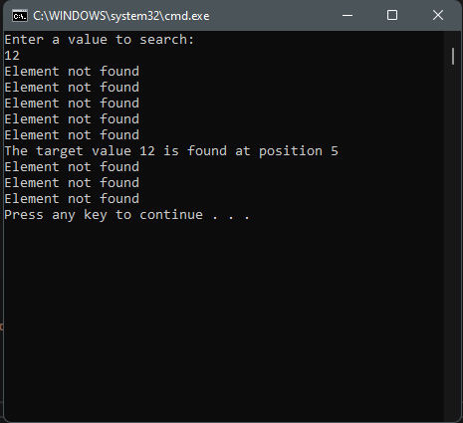
Output

Slide 7
FIN.

